Slide 1
WALES ANTI SLAVERY AWARENESS FOR UNIVERSITIES A BRIEF INTRODUCTION
Notes:
This will equip professionals and others to have an awareness of the causes and signs of slavery of adults and children.
Explain to delegates that the blue blindfolded dragon is now the emblem that ensures quality and denotes any training/notes/information disseminated from the Wales Anti-Slavery Leadership Group.
It is worth mentioning at this point that the UN Convention on the Rights of the Child concludes that a child is any person under 18 years. This is because it is universally accepted that a child under 18 cannot consent to being exploited. The Sexual Offences act 2003 also states that 16/17 year olds cannot consent to exploitation – this is an age group that people often think can take care of themselves.

Slide 2
AIM:
To raise awareness about the exploitation of human beings
To understand your personal and universities role to respond to tackling anti slavery
How you can contribute to making our country hostile to slavery.

Slide 3

Wales Anti Human Slavery logo

Slide 4

CPS Prosecutor Commitments
We will build stronger cases to support these most serious offences
We will ensure that the rights and welfare of victims are at the heart of our approach to investigation and prosecution
We will continue to deliver training and development to prosecutors and law enforcement to improve our expertise
We commit to developing and maintaining effective means of engagement with NGOs.
We will work closely together to learn lessons, exchange good practice and share relevant information, data and contacts.

Slide 5
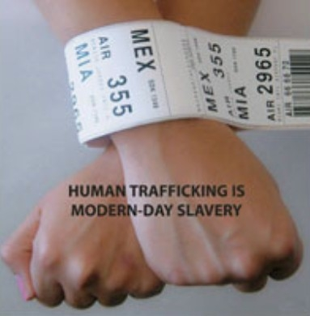
WHAT IS MODERN SLAVERY?
Notes:
The most simple explanation for ‘slavery’. Despite being outlawed on both sides of the Atlantic since 1805, the trade in human slaves has not stopped. It has simply been driven ‘underground’ by being prohibited.
Modern slavery includes: human trafficking, slavery, servitude, forced & compulsory labour
Human trafficking is the fastest growing form of slavery today and is prohibited under international law, as well as under the criminal laws of the United Kingdom and other countries.
The home office estimated in 2013 there were between 10,000 & 13,000 victims of modern slavery in UK
5

Slide 6
TYPES OF EXPLOITATION
These are fairly wide ranging and often include the following types of conduct:
Sexual Exploitation
Forced Labour
Forced criminality
Domestic Servitude
Organ harvesting
Child Exploitation.
Did you know
Labour exploitation is the most recorded form of slavery in the UK , accounting for 36 percent of recorded NRM cases (NCA, 2015)
Notes:
Sexual - frequently through prostitution where victims are placed into off-street brothels, forced to see many clients, and receive either little or no money.
Forced labour - where victims are forced to work very long hours and hand over all of their wages to their traffickers or controllers, e.g. domestic situations as sweatshop factories, construction sites, farm work, paving/ tarmacking, manufacturing, food processing, hospitality
Criminal – drugs, cannabis farming, organised crime, begging, benefit fraud, shoplifting/Theft, Credit card/ATM fraud, Selling Stolen Goods, DVD Pirating and Sales, pick pocketing
Domestic Servitude - victims who live and work in households where they are forced to work through threats of serious harm and physical and sexual assaults, ill treated, humiliated, long hours, unbearable conditions for little or no pay.
Organ harvesting - where victims are trafficked in order to sell their body parts and organs for transplant; eggs, kidneys, liver, eyes (China)
Children - children are amongst the most vulnerable victims; sometimes they are sold into forced labour or domestic work through debt bondage by family members where they are vulnerable to sexual or physical abuse.

Slide 7
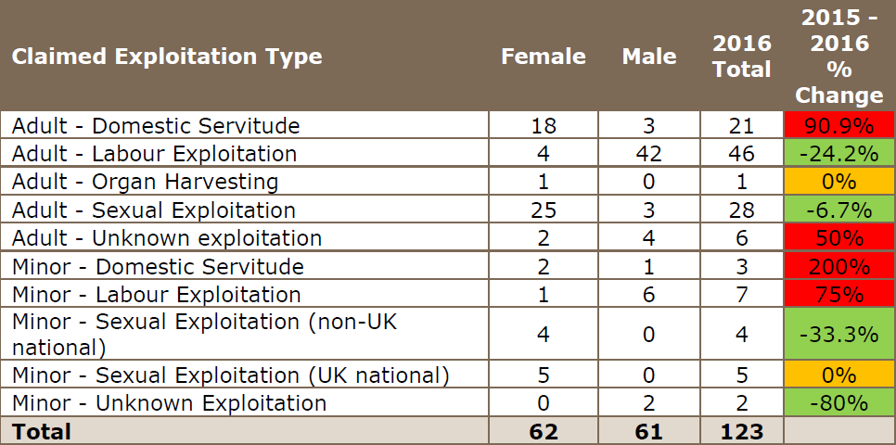
Wales NRM Data 2016
Notes:
The top 6 countries were Vietnam / Eritrea/ Nigeria/ Sudan / UK / Albania

Slide 8
ACTIVITY
In your groups:
What might make children and adults vulnerable to being pulled in to slavery?
How are they recruited?
Where/ how might you find victims of slavery being exploited in the UK?
Notes:
In other words what “pushes” them into the trafficking world?
What makes it easy for them to be recruited? What pulls them in to trafficking
The list of where you might find a victim is endless so we haven’t done a slide for this.
Show the following 2 slides to ensure they have covered all the push & pull factors.
Where / how might you find victims – everywhere
Examples are
Brothels
Nail bars
Farms
Private homes
Traveller sites
Hospitality
Car washes
Factories
Ships
Cannabis farms

Slide 9
WHY ARE THEY VULNERABLE?
Vulnerability
Factors
Violence (inc harmful traditional practices)
Conflict or natural disaster
Poverty
Gender and
Equality Issues
Substance dependency
Slavery endemic in area
Demand for cheap labour
Family debt
Lack of
opportunity
Notes:
Push factors are ways in which victims are vulnerable and therefore encouraged into trafficking:
Mental or physical health issues
Coming from a history of domestic or other violence
lack of employment or education
Culture and societal norms
Lack of opportunity for legal migration
Forced displacement, such as through conflict and climatic events

Slide 10
RECRUITMENT
Vulnerability
Factors
Employment
Support family back home
Better lifestyle
Improved social position in own country
Education
Love
Perceived safety
A Home
Expensive lifestyle
Notes:
Pull factors are complex factors that can fuel trafficking and make it easy for a trafficker to coerce a victim in to trafficking. It’s often something that the trafficker highlights is a need within the vulnerable person & therefore they use this as a way of pulling them in:
Employment & financial reward/benefit in developed countries
Perceptions of better lifestyle in developed countries
Opportunity to earn money and support family back home
Improved social position within own community
Promise of education
Employers demand for cheap labour/Consumers demand for cheap goods and services
Market gaps not filled by local labour supply
Being loved by someone
Feeling protected & safe
Provision of a roof over their head
An expensive lifestyle being provided which at some point will need to be repaid or services provided to sustain it.

Slide 11
Signs/ Indicators
Having no personal identification or passport/documents held by someone else
Lack of money/control over own finances or lack of access to earnings
Living/sleeping In the place of work
Any evidence of control of movement either as an individual or group
Limited contact with family& limited social contact
Others seeking to speak for the person you are trying to engage
Living or found in ‘degrading’ conditions
Children not in education.
Notes:
No passports or papers – traffickers are wise to this now and making sure they have false documents.
No days off or holiday time & imposed work conditions
Being restricted from freely leaving work
Appearing anxious/nervous around ‘Family Member’ or ‘Interpreter’
Employer providing transportation to/from work daily
Threats against family members
Signs of physical abuse
Excessive response Perception of being debt bonded

Slide 12
Signs/ Indicators
Children living with non relevant families
Signs of branding/ownership
Limited contact with family& limited social contact
Signs of physical abuse
Injuries apparently as a result of assault or ill treatment, as a result of work, or from restrains such as shackles or rope
Lack of access to medical care
Extreme reaction to authority or a dominant male or female (fear, shying away, overly suggestive)
Lifestyles they cannot afford, e.g. new mobile, clothes, money, food, etc.
Notes:
For young people being internally trafficked remember: Expensive lifestyles, e.g. new mobile, clothes, money, food, etc.
Older boyfriends (5 years plus)

Slide 13
Barriers to disclose
Lack of awareness that they are the victim of a crime
Unaware that help is there
Language barrier
Controlled movements
Fear of Repercussions
Accompanied by trafficker
Isolation.
Comparison of situation to a worse one
Immigration status
Involvement in criminal activity
Juju
Lack of trust of authorities
Self-blame
Stigma
‘Stockholm Syndrome’.
Notes:
Stockholm syndrome, or capture–bonding, is a psychological phenomenon in which hostages express empathy and sympathy and have positive feelings toward their captors, sometimes to the point of defending them. These feelings are generally considered irrational in light of the danger or risk endured by the victims, who essentially mistake a lack of abuse from their captors for an act of kindness.
Stockholm syndrome can be seen as a form of traumatic bonding, which describes “strong emotional ties that develop between two persons where one person intermittently harasses, beats, threatens, abuses, or intimidates the other
It suggests that the bonding is the individual’s response to trauma in becoming a victim. Identifying with the aggressor is one way that the ego defends itself. When a victim believes the same values as the aggressor, they cease to be a threat.
Inform delegates that there aer orgnaisaiotns that provide support and assistance to victims

Slide 14
power and control can be driven by a number of factors - look out for
What is the relationship between the offender and victim?
What are the circumstances that contribute to a person being a victim?
What does an offender gain from the relationship?
How is a Victim Controlled?
Notes:
What is the relationship between the offender and victim?
(Parental / Family / work related)
What are the circumstances that contribute to a person being a victim?
(Age / Mental health / Addictions / Social Ability)
What does an offender gain from the relationship?
(Control / Money / Belief Systems)
How is a Victim Controlled?
(Threats or Violence / Money / Addictions / Moral obligation)

Slide 15
Simple message
Look, Understand and Help

Slide 16
Potential Victim
Immediate risk of harm Dial 999/ 101
Report , Advice and Guidance –
Modern Slavery Helpline 08000 121 700
Notes:
Crimes committed by the victim should also be secondary.
16

Slide 17


Slide 18
FIRST RESPONDERS IN WALES
Police
UK Border Force
Home Office Immigration and Visas
Gangmasters and Labour Abuse Authority
Local Authorities
Salvation Army
BAWSO
Barnardos
New Pathways
NSPCC
Notes:
The person completing the referral form is known as the first responder
Introduced in 2009 to ensure we’re meeting EU regs. on trafficking
CHAPS – Cardiff Health Access Practice Service
Consent needed to put in NRM form for adults only. Consent not needed for children
inform delegates that if they are from a first responder organisation that they have a duty Referrals into the NRM
Best for NRM form to be completed by 1st responder so that the quality of information provided gives the person a fighting chance to meet the criteria for the 45 day period.
The NRM is the national framework for the protection and assistance of victims of human trafficking adopted in the UK to:
• Identify victims of human trafficking;
• Provide them with the care they are entitled to;
• Provide them with the 45-day reflection and recovery period; and
• To ensure their human rights are respected.
Referrals into the NRM must be made by a ‘First Responder’ (e.g. Police, Social Services)

Slide 19
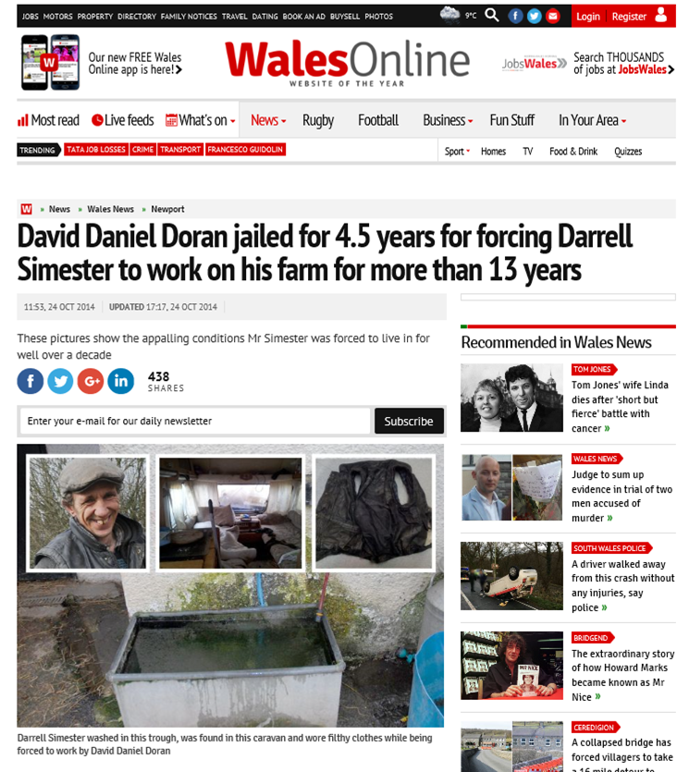
Notes:
These are the horrendous conditions suffered for more than 13 years by a man who was forced to work without pay on a farm.
Forced to wash in a trough meant for animals and live in a rat-infested shed, Darrell Simester was found in an “appalling state” on Cariad Farm outside Newport.
The man who forced him to work for well over a decade - while his family had no idea what had happened to him - has been jailed.
David Daniel Doran, 42, admitted forcing Simester to work on his farm, which Mr Simester’s family said had made him “unrecognisable” from the man they had last seen.
He has been jailed for 4.5 years.

Slide 20
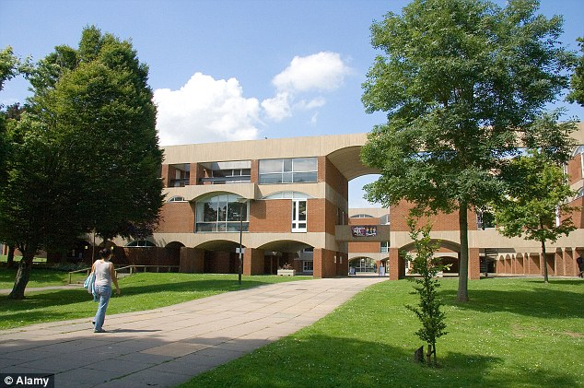
University of Sussex

Slide 21
Pimps jailed for using university halls as a brothel in major sex trafficking operation involving more than 50 women from eastern Europe
Casba Safian, 33, ran operation from a house in Eastbourne, East Sussex
Sandor Mohacsi, 35, also worked for gang which used university halls as brothel at University of Sussex’s Falmer Campus, East Sussex.
Women as young as 17 from poor parts of Hungary had sex 15 times a day
Advertised on websites as 'fresh meat' and threatened with exposure if fled
Both defendants jailed at Hove Crown Court for two years and eight months
Notes:
A court heard the group ran brothels from various locations, including a room in student accommodation during the holidays at the University of Sussex’s Falmer Campus, East Sussex.
Read more: http://www.dailymail.co.uk/news/article-2717842/Pimp-jailed-using-university-rooms-brothel-major-sex-trafficking-operation-involving-50-women-eastern-Europe.html#ixzz4Xtp2A4wA

Slide 22
MODERN SLAVERY ACT 2015
Introduces offences – England and Wales from 31 July
Penalties
Prevention and Risk Orders
Independent Anti-Slavery Commissioner
Protection of Victims
Transparency in the Supply Chain October 2015
Notes:
Provide and An overview of the offences
There are 2 offence. These are
Slavery servitude and forces or compulsory labour
Human trafficking
inform delegates of additional provisions below
Up to life imprisonment – previously up to 14 years
Legal duty of notification to NCA re potential victims of modern slavery
If age of victim uncertain , to be presumed as child
Provide powers to enable police and Border Force to act where it is suspected that human trafficking or forced labour is taking place
Child Trafficking advocates: appoint legal representative for child.
Prevention orders
Applied for:
by Prosecutor on conviction as part of the sentence, to protect the public by preventing or restricting defendant’s activities e.g. working as a gangmaster, travel to specified countries, working with children.
by Police/NCA/Immigration Officer (IO) at a Magistrates’ court to prohibit the defendant from doing anything described in the order. The defendant must have been convicted of a trafficking offence in the UK or any other
country.
Risk orders
Applied for:
by Police /NCA /Immigration Officer at a Magistrates’ Court to restrict the activities of an individual who has not been convicted of a relevant offence, but where it is necessary to protect people from likely harm.
Modern Slavery Act link ….http://www.legislation.gov.uk/ukpga/2015/30/pdfs/ukpga_20150030_en.pdf
Additional info below if needed - but if delegates need more info re the Modern Slavery Act they need to do the First Responder course
Section 1.
Slavery, servitude and forced or compulsory labour: offence even if individual consents Section 2.
Human trafficking for exploitation. Section 4.
Committing offence with intent to commit offence under section 2. Includes any offence including the aiding, abetting, counselling or procuring
Section 45:
a defence for slavery or trafficking victims who commit an offence.
Not inclusive all offences however with more serious offences, violence and sexual offences not covered.
Interestingly it would appear that the defence could apply, for instance, in cases of ABH, theft or dangerous or drink driving.
Previous offences were spread out to :
Sexual Offences Act 2003 – prohibited trafficking for sexual exploitation
Asylum and Immigration (Treatment of Claimants etc) Act 2004 – prohibited trafficking for non-sexual exploitation
Coroners and Justice Act 2009 – prohibited slavery, servitude and forced or compulsory labour

Slide 23
Modern Slavery Act Section 52 -
imposes a duty to notify the Home Office about suspected victims of MDS.
From 1 November 2015, specified public authorities have a statutory duty to notify of any suspected victim they come across.
The “duty to notify” applies to key public authorities
Certain information must be provided within a notification has been set out in regulations by the Secretary of State.
Adults again must consent ( over 18).
If no consent - notification is still required but information that could result in identification should be removed.
Notes:
Hand out poster and sticker re the duty to notify. Details of the duty are outlined below
from 1st November 2015, specified public authorities have had a duty to notify the Secretary of State of any individual encountered in England and Wales who they believe is a suspected victim of slavery or human trafficking. This duty is intended to gather statistics and help build a more comprehensive picture of the nature and scale of modern slavery.
The Home office have produced some materials to raise awareness of the Duty to Notify. Please find attached the materials as PDF’s which are also downloadable here https://www.gov.uk/government/publications/modern-slavery-duty-to-notify . I await welsh versions
Please note that there are two versions of the poster, one is for those covered by the duty to notify legislation, the other poster is for partners such as the NHS frontline staff (who are not covered by the duty, but who may regularly come into contact with potential victims, this poster is worded it is important to notify…).
It is estimated that there were 10,000-13,000 victims of modern slavery in the UK in 2013, but only 1,746 potential victims were referred to the National Referral Mechanism (NRM) in the same period. In 2015, this figure rose to 3,266 potential victims.
The ‘duty to notify’ provision is set out in Section 52 of the Modern Slavery Act 2015, and applies to the following public authorities in England and Wales at the time of publication (additional public authorities can be added through regulations):
(a) a chief officer of police for a police area,
(b) the chief constable of the British Transport Police Force,
(c) the National Crime Agency,
(d) a county council,
(e) a county borough council,
(f) a district council,
(g) a London borough council,
(h) the Greater London Authority,
(i) the Common Council of the City of London,
(j) the Council of the Isles of Scilly,
(k) the Gangmasters Licensing Authority.

Slide 24
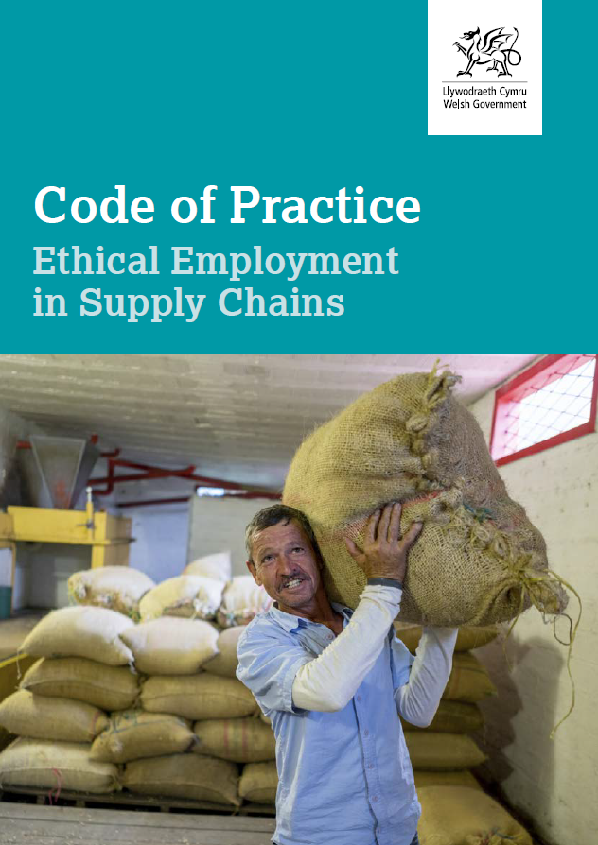
Notes:
Section 54 MSA 2015

Slide 25
Student Life
Better understand how vulnerable students can be to exploitation
Student study far from home even in different countries therefore at risk of exploitation
Student may consider the Possibility of becoming a sex worker to fund student fees and easy to be targeted for exploitation

Slide 26
Academia Role
Ensure all Academic courses include a module on Modern Slavery
Consider the need for students to appreciate they are members of their local community and have a role to play
Appoint Anti Slavery Ambassadors at lecturer and student level

Slide 27
Universities ……. The Way forward
Work in partnership
Establish strategic Modern Slavery Network across academia
Roll out anti slavery awareness training
Draft a university strategic modern slavery strategy
Consider requirements under Section 54 – Modern Slavery Act 2015

Slide 28
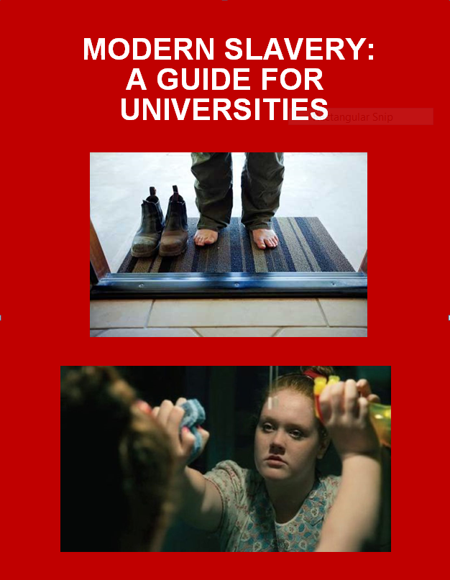

Slide 29
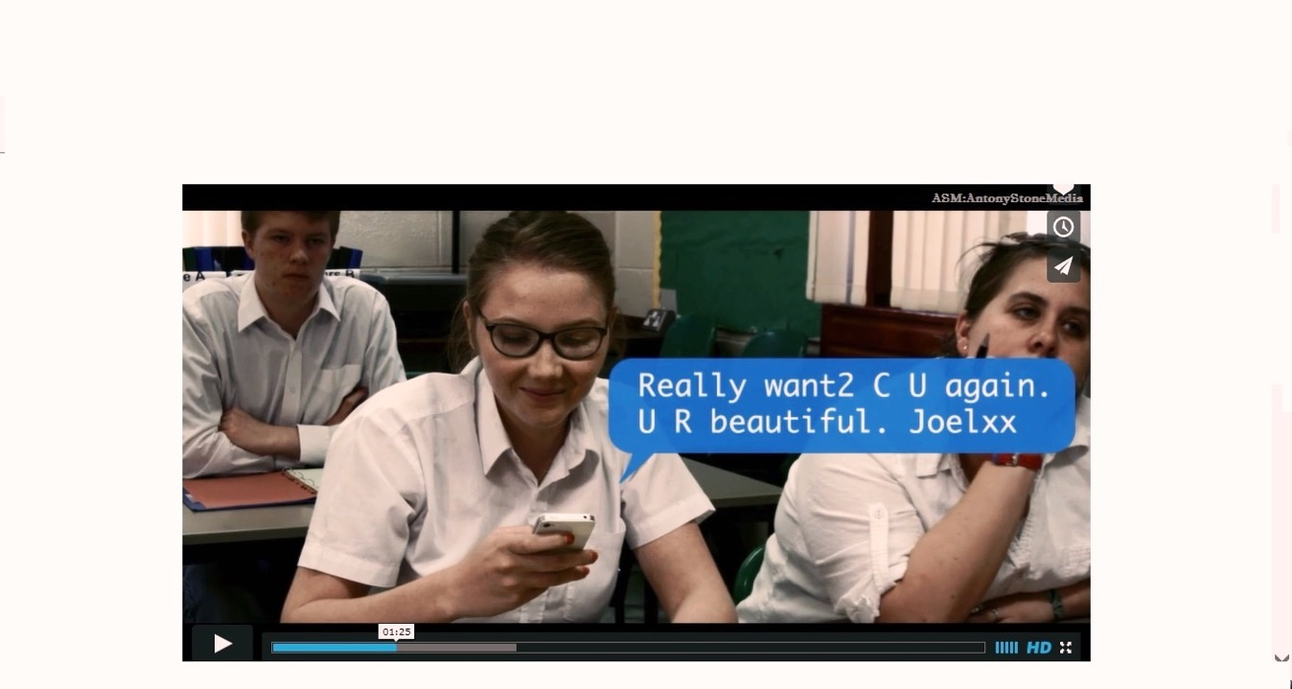
Caught in Traffick

Slide 30
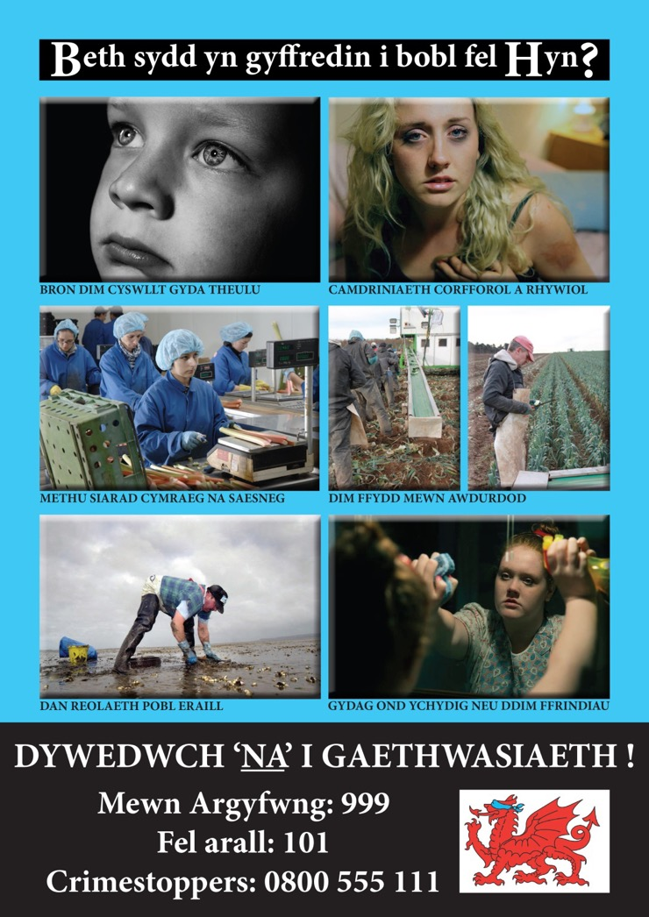
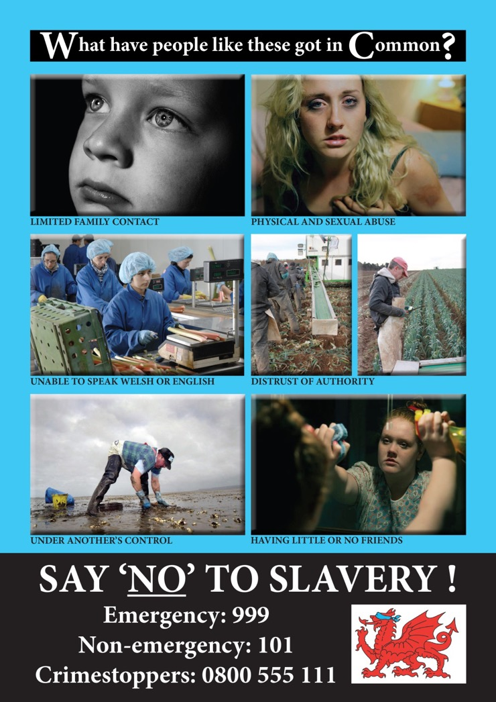
Notes:
These slides are intended to highlight the impactive use of images. There is however, no generic image of a trafficked victim and they don’t have labels saying they’ve been trafficked

Slide 31

“Our Message in Wales is”

Slide 32
‘SLAVERY TAKES PLACE IN YOUR COMMUNITY AND CAN BE STOPPED BY THE COMMUNITY’
YOU COULD SAVE A LIFE

Slide 33

“Thank you – Diolch yn fawr”
“We are Modern Slavery victims only chance of Freedom ”
Kim Ann Williamson, 2017
Contact details:
Kim-Ann Williamson
CPS Cymru wales
Tel: 029 2080 3904
Mobile: 07717835272
E-mail: KimAnn.Williamson@cps.gsi.gov.uk
Web-site: www.wales.gov.uk/anti-slavery

